Slide 1

Designing a Redundant, Secure, and Efficient Data Center Network: A Case Study at University
Presenter: Junesh, Ashlyn, Ujjwal
Acknowledgment: SDSU HPC Team
Course: Computer Networking
April 23rd 2025

Slide 2

Project Overview
This project aims to design a data center network for our campus that supports the rising demands of HPC, emphasizing redundancy, security, and efficiency. It addresses the rapid expansion of data centers, driven by trends like edge computing, colocation, and increased HPC use in research, while incorporating Net+ and industry best practices.

Slide 3
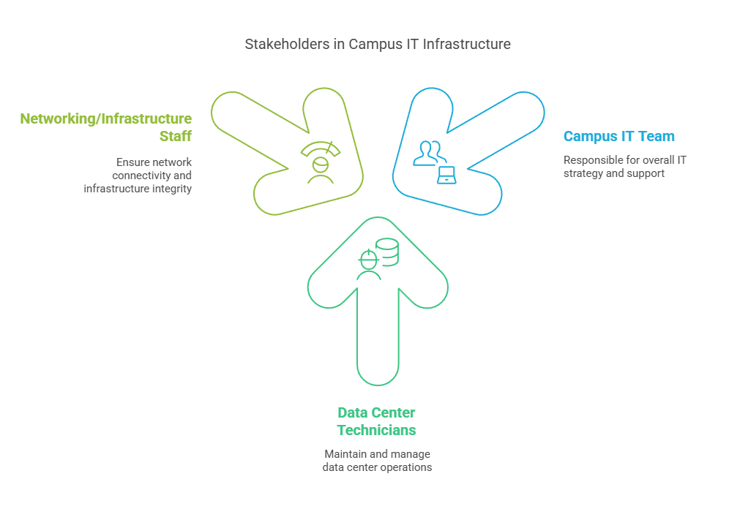
Key Stake Holders

Slide 4
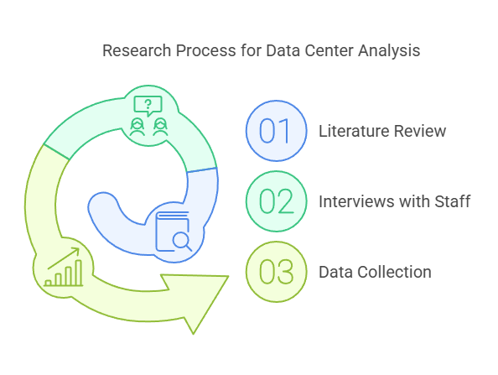
Research Approach
Literature review on relevant Net+ topics, interviews with local data center staff, and collection of data center stats (power usage, network diagrams, capacity).

Slide 5
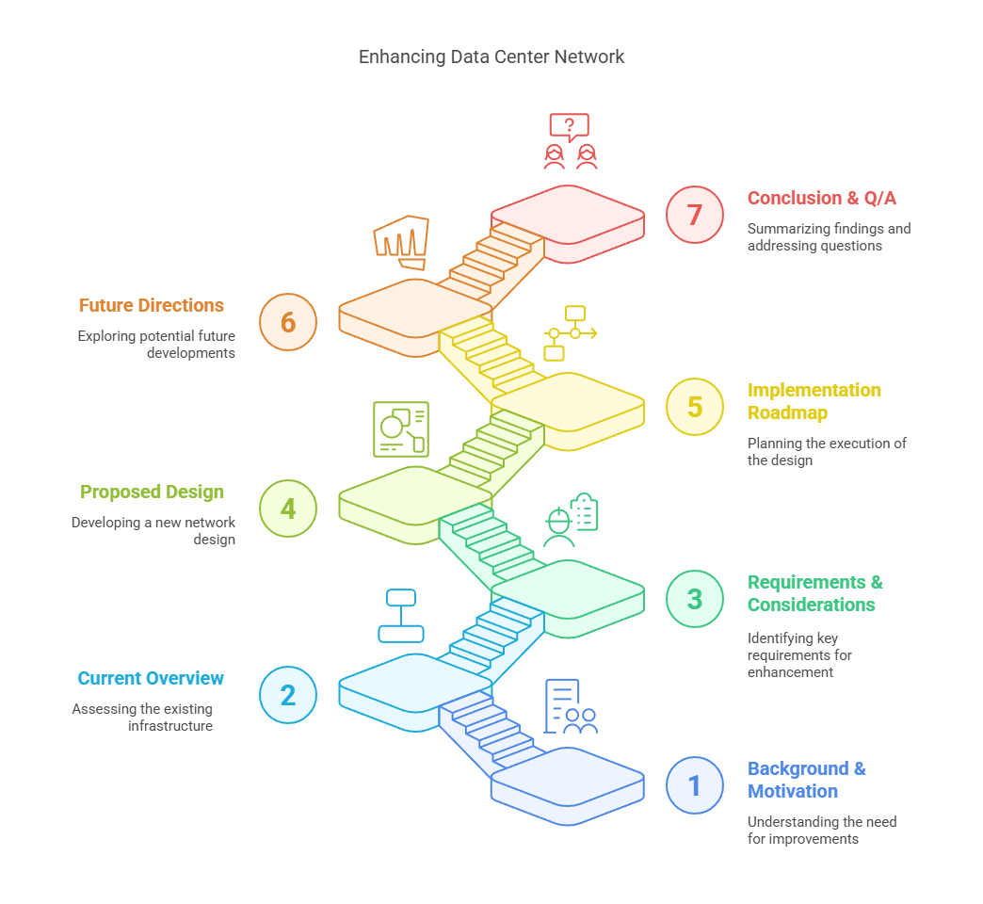
Agenda

Slide 6
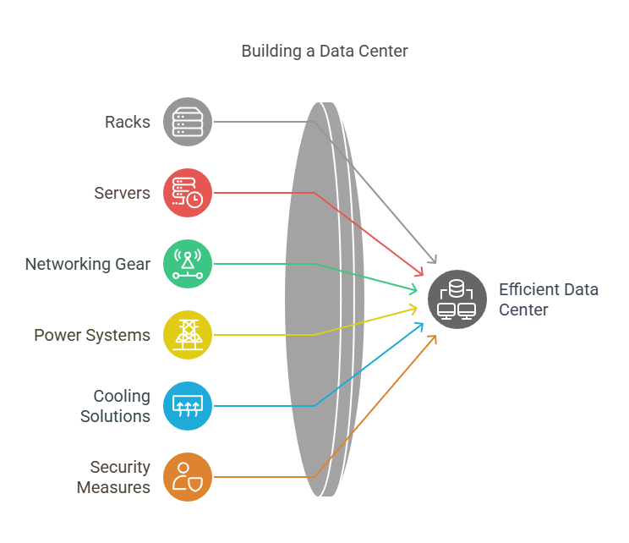
Background And Motivation

Slide 7
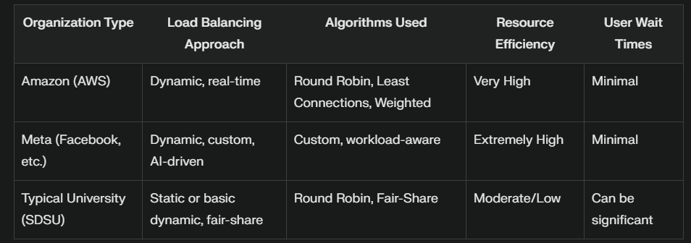
Notes:

Slide 8
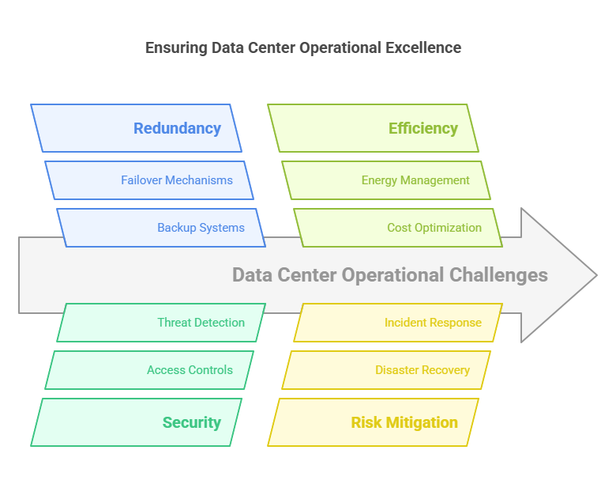
Why Redundancy, Security, and Efficiency Matter
Redundancy, security, and efficiency are critical for maintaining uptime, managing costs, optimizing energy usage, and mitigating risks. Historical data center failures highlight the importance of these factors in ensuring continuous operations.

Slide 9
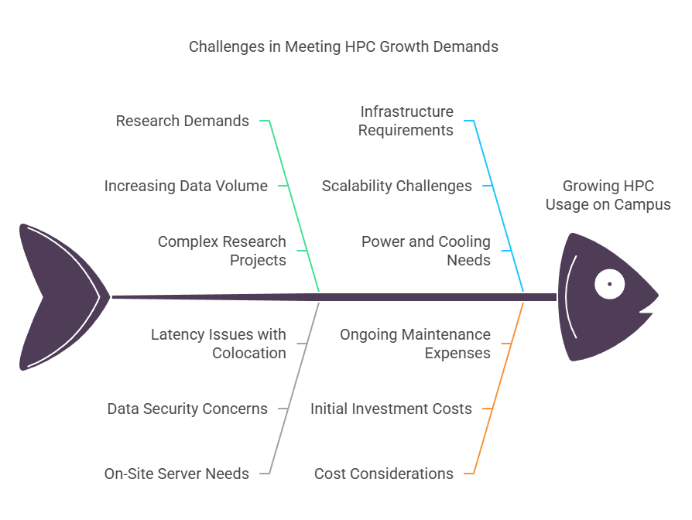
University Environment Context
The HPC usage on campus is growing, driven by increasing research demands and the need for on-site servers versus external colocation. The growth in student and faculty research data necessitates a robust data center infrastructure.

Slide 10
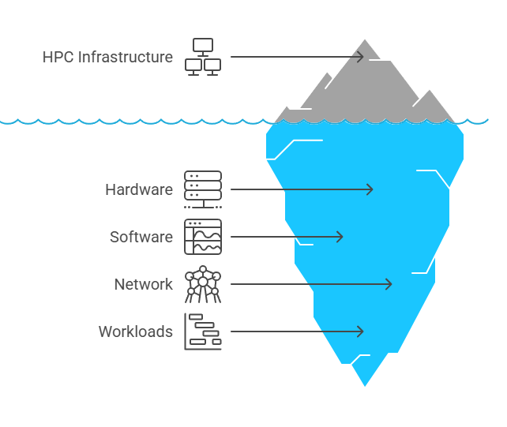
Current HPC Lab

Slide 11
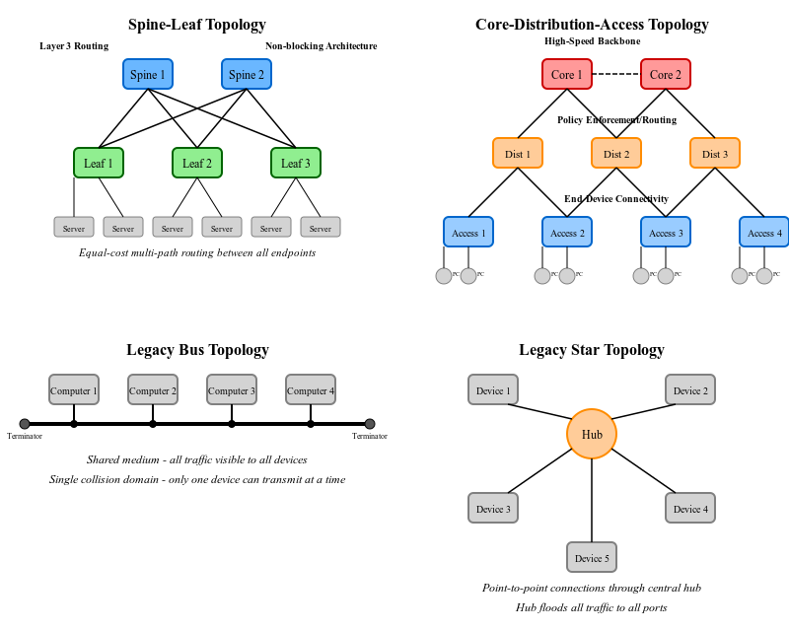
Network Architecture

Slide 12
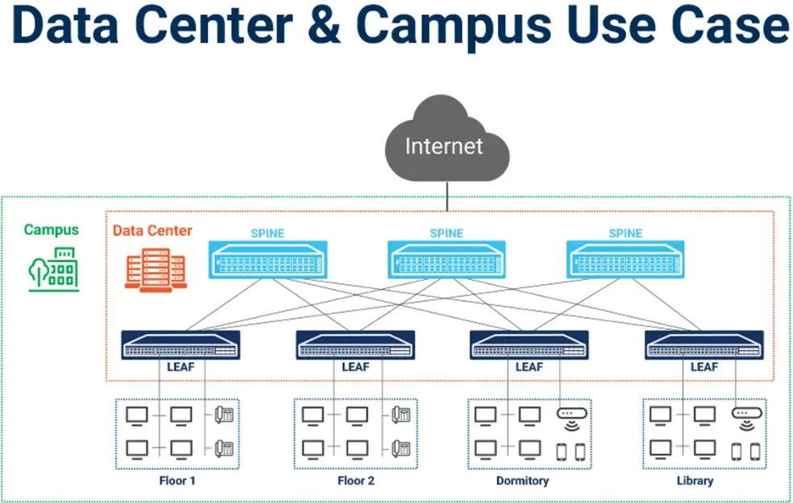
Spine-Leaf Architecture
References: https://stordis.com/spine-leaf-vs-traditional-data-center-architectures/

Slide 13
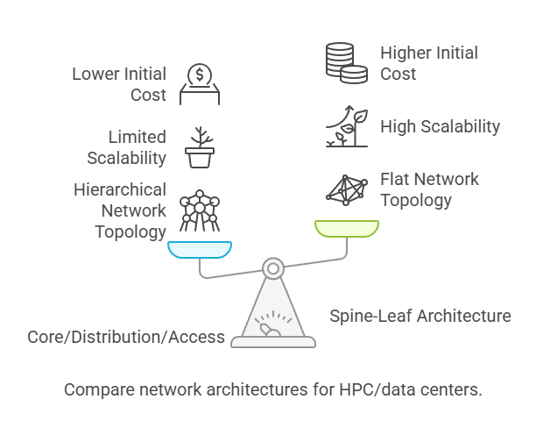
Comparison

Slide 14
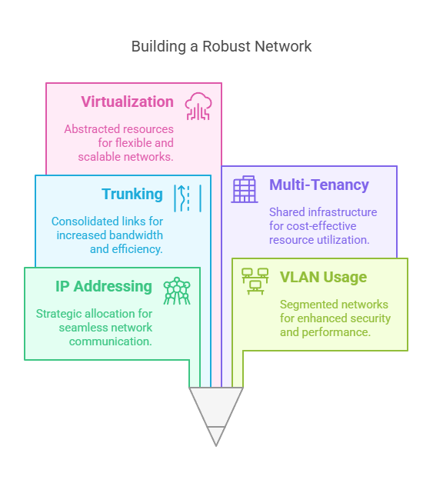
Network Infrastructure Analysis

Slide 15
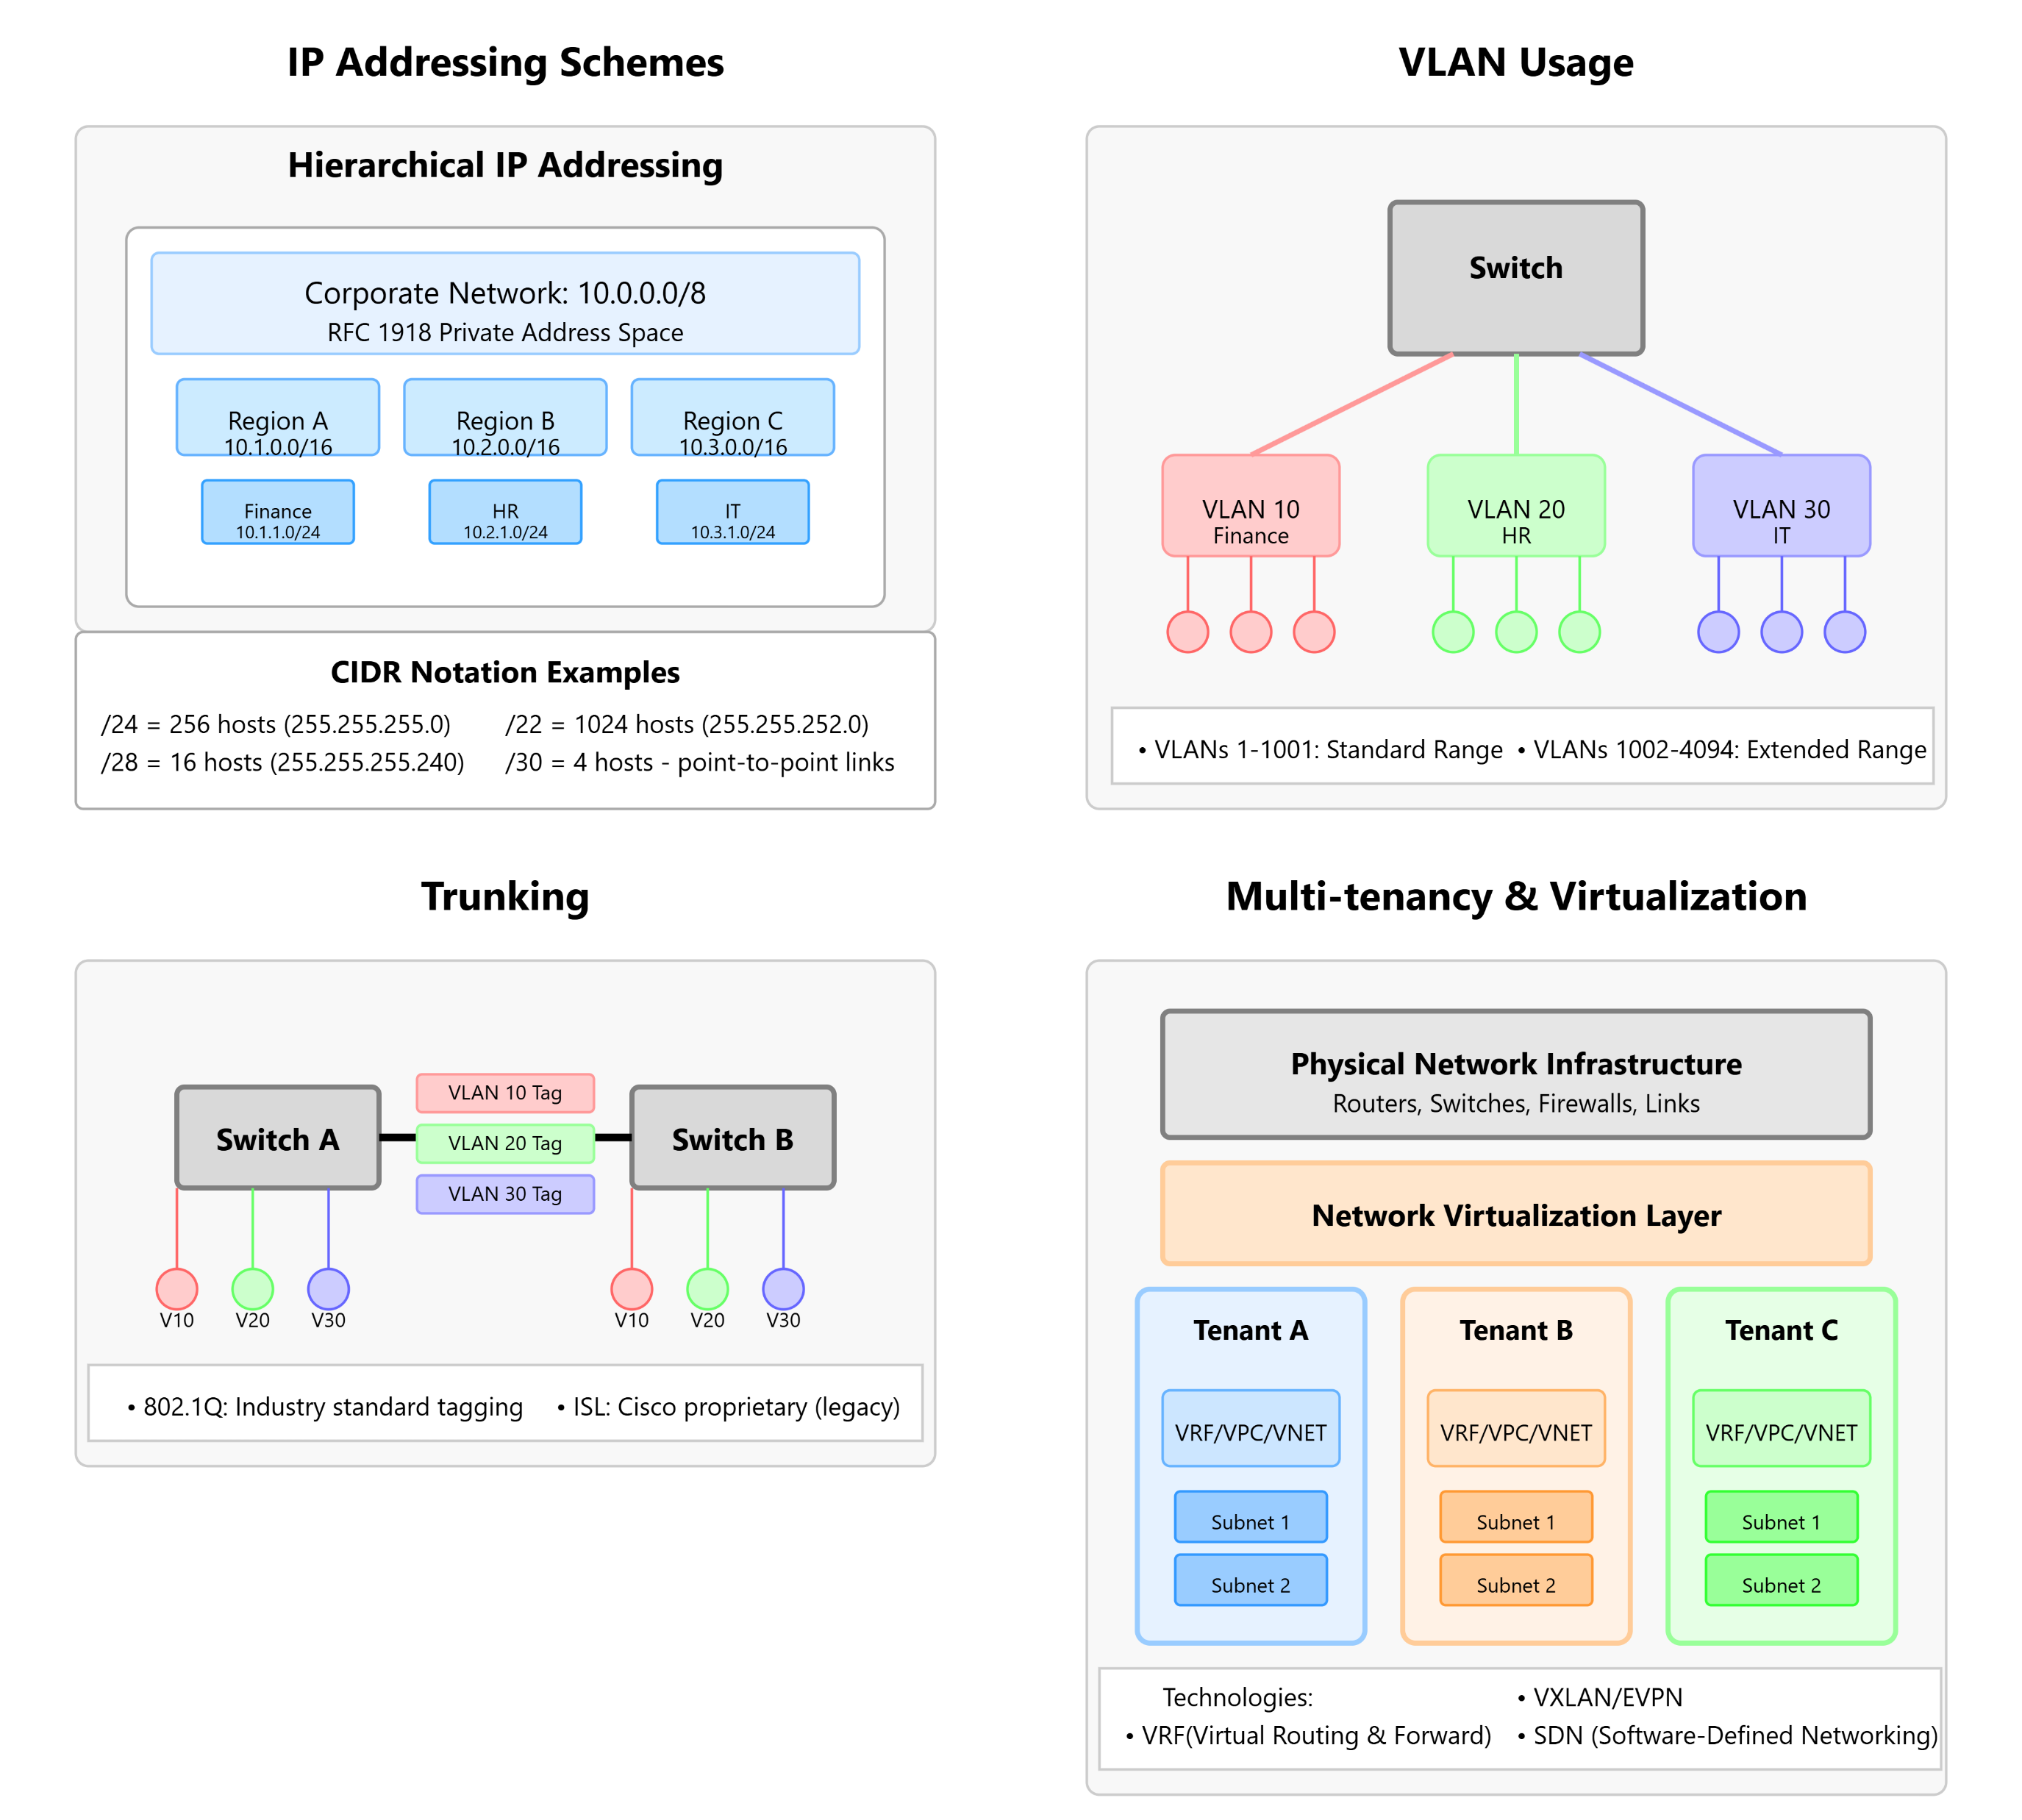
Comprehensive Network Infrastructure Analysis

Slide 16
Security Approach
Physical Security (entry systems, guard presence, Cameras)
Logical security ( Firewall, VLANS, Intrusion Detection, etc.)

Slide 17
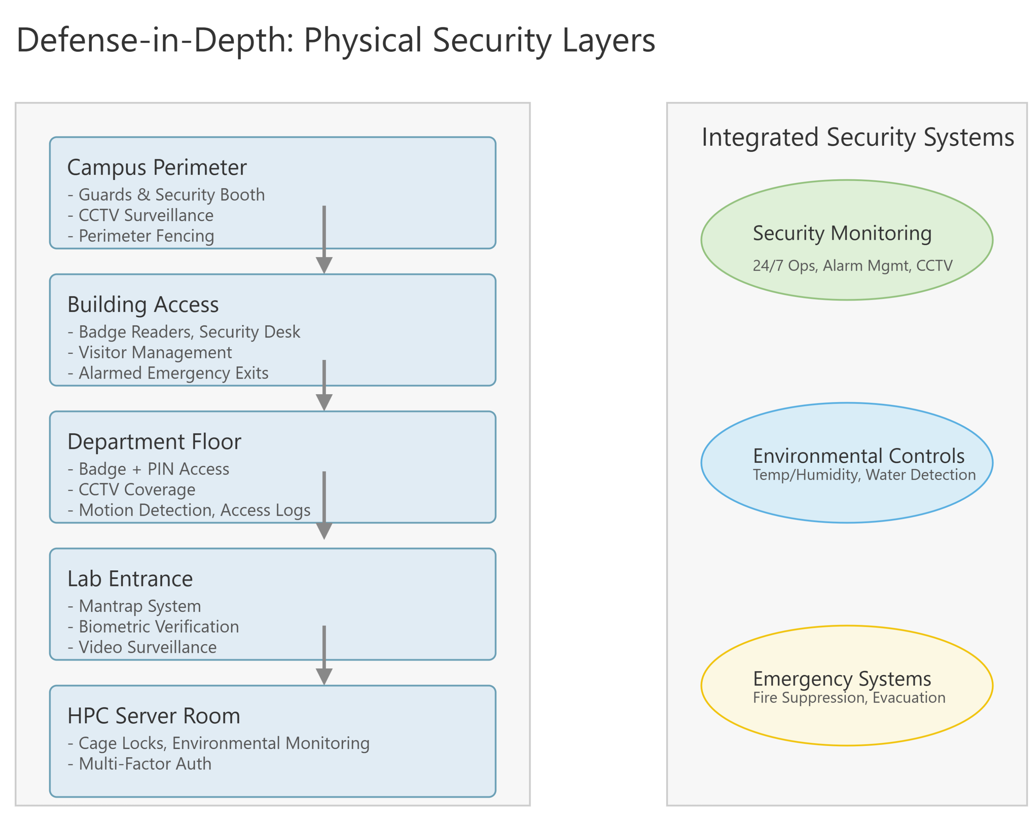
Physical Security

Slide 18
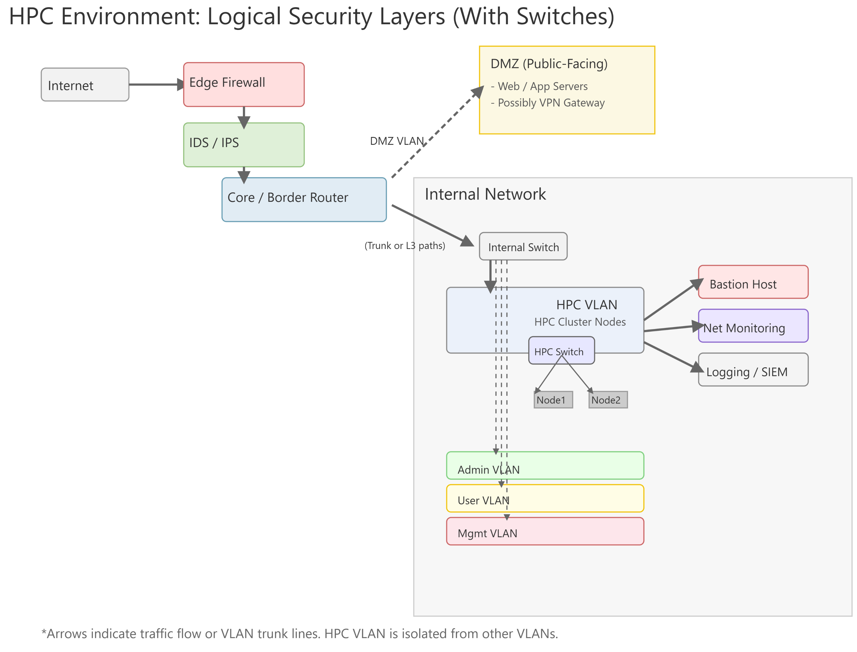
Logical Security

Slide 19
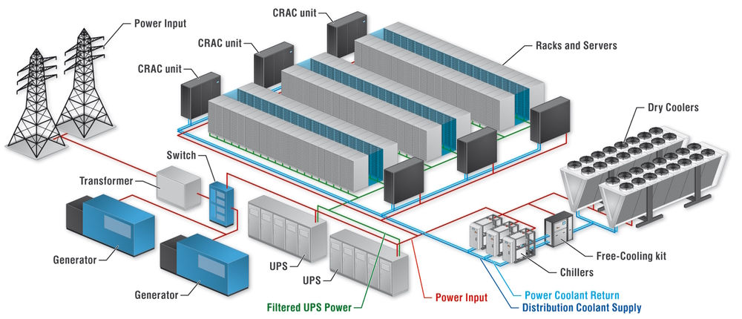
POWER AND COOLING

Slide 20
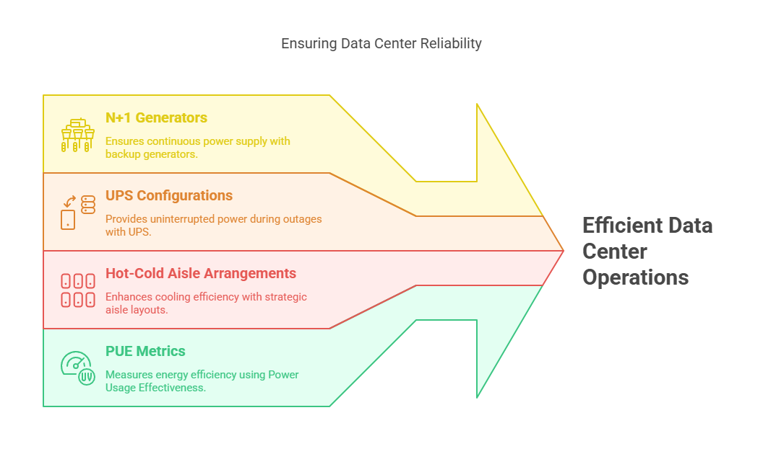
Power & Cooling

Slide 21
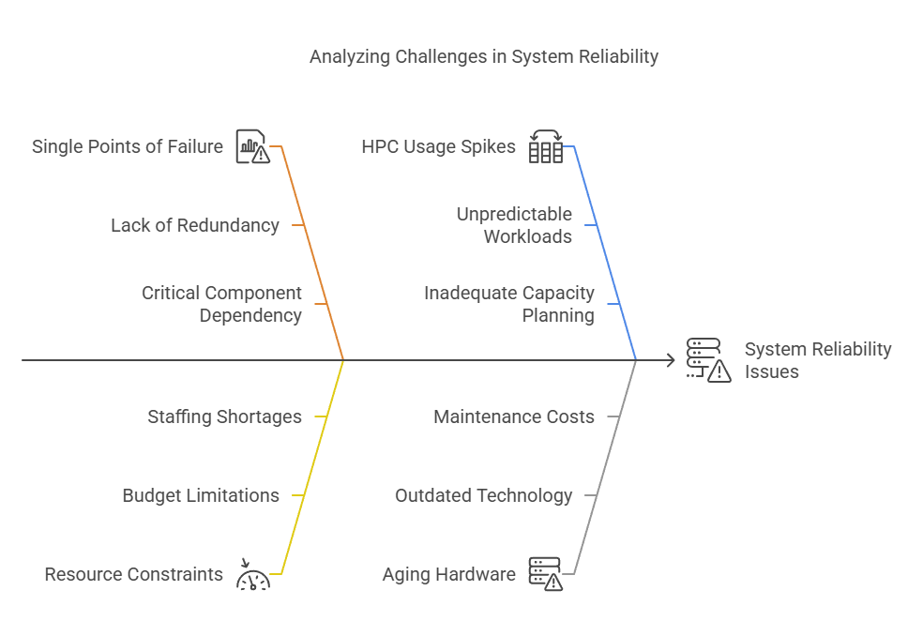
Challenges

Slide 22
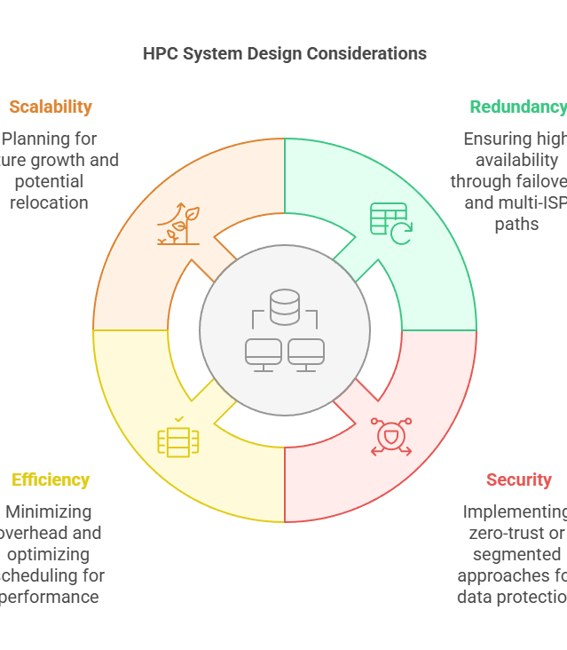
Requirements & Key Considerations

Slide 23
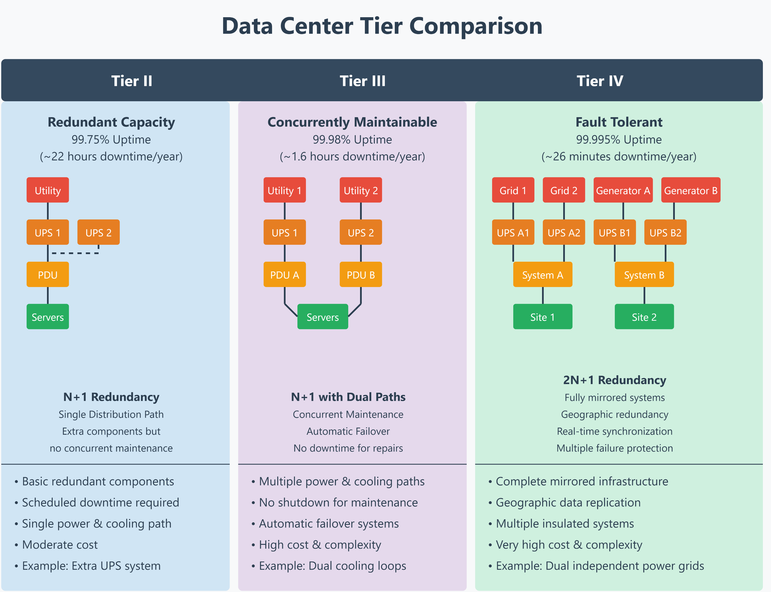
Common Tiers

Slide 24
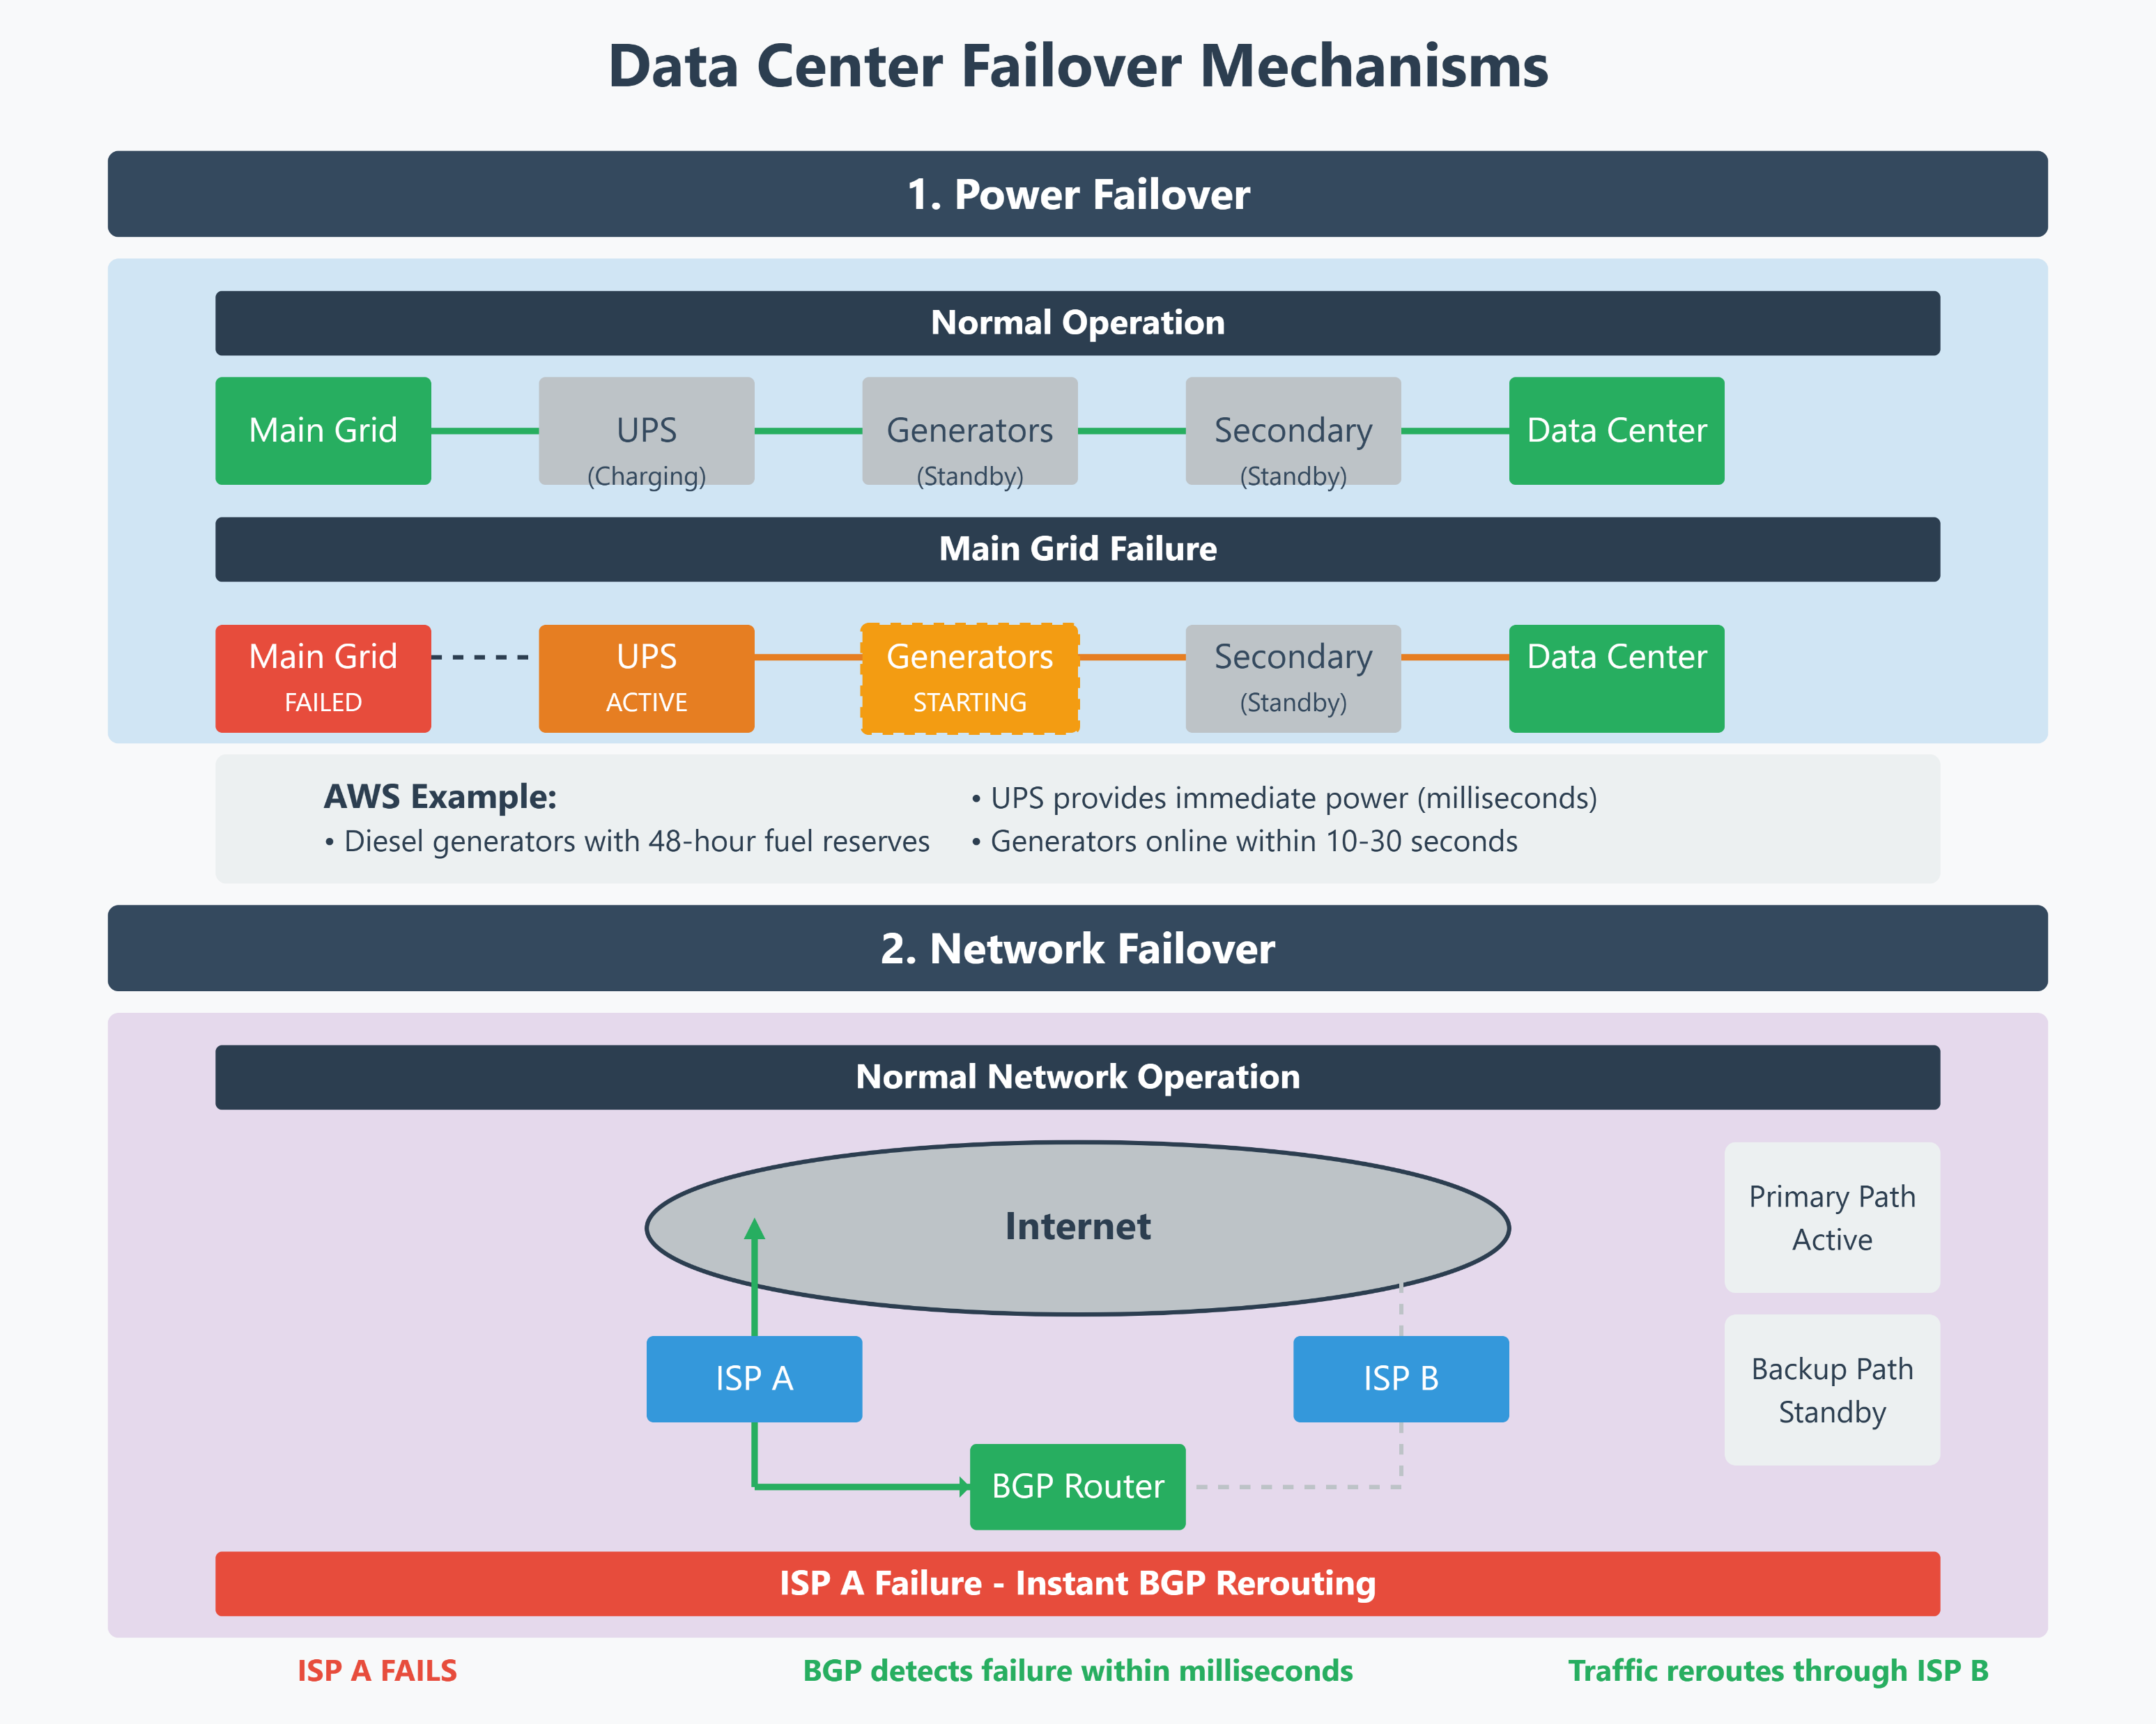
Failover Mechanism

Slide 25
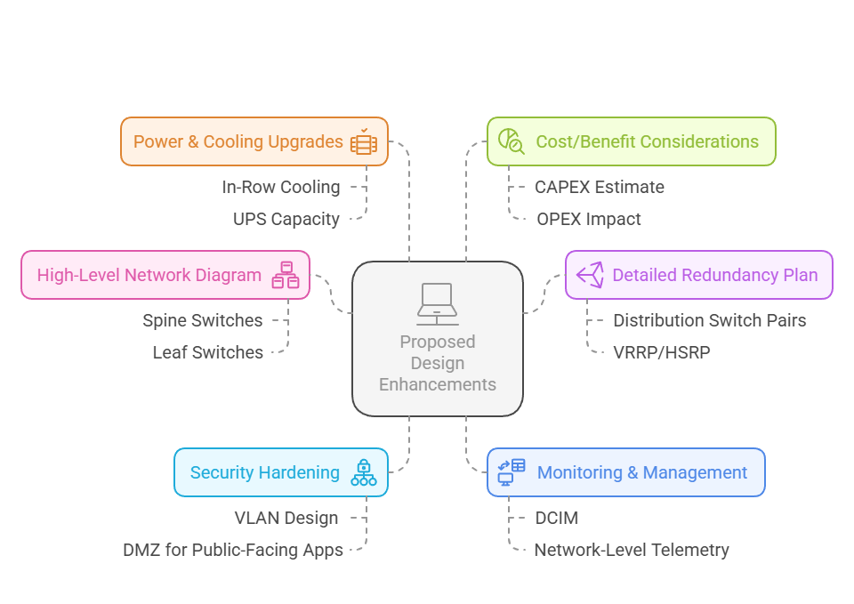
Proposed Design

Slide 26
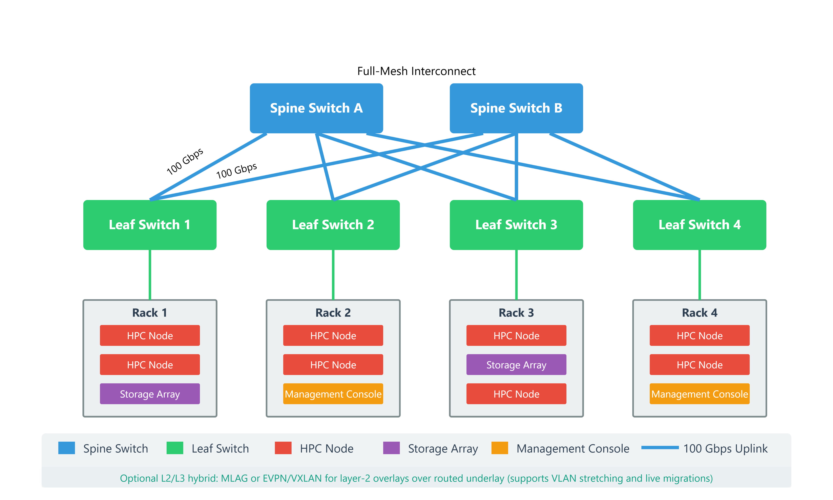
High‑Level Network Diagram
Spine‑Leaf with Redundant Paths

Slide 27
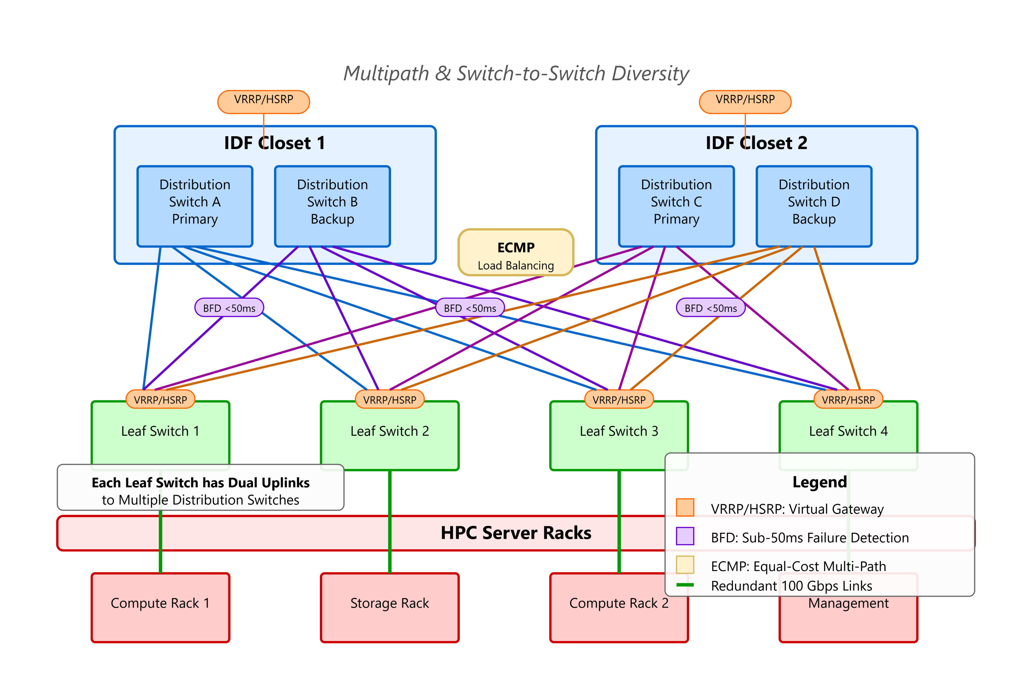
Redundancy Plan
Multipath & Switch‑to‑Switch Diversity

Slide 28
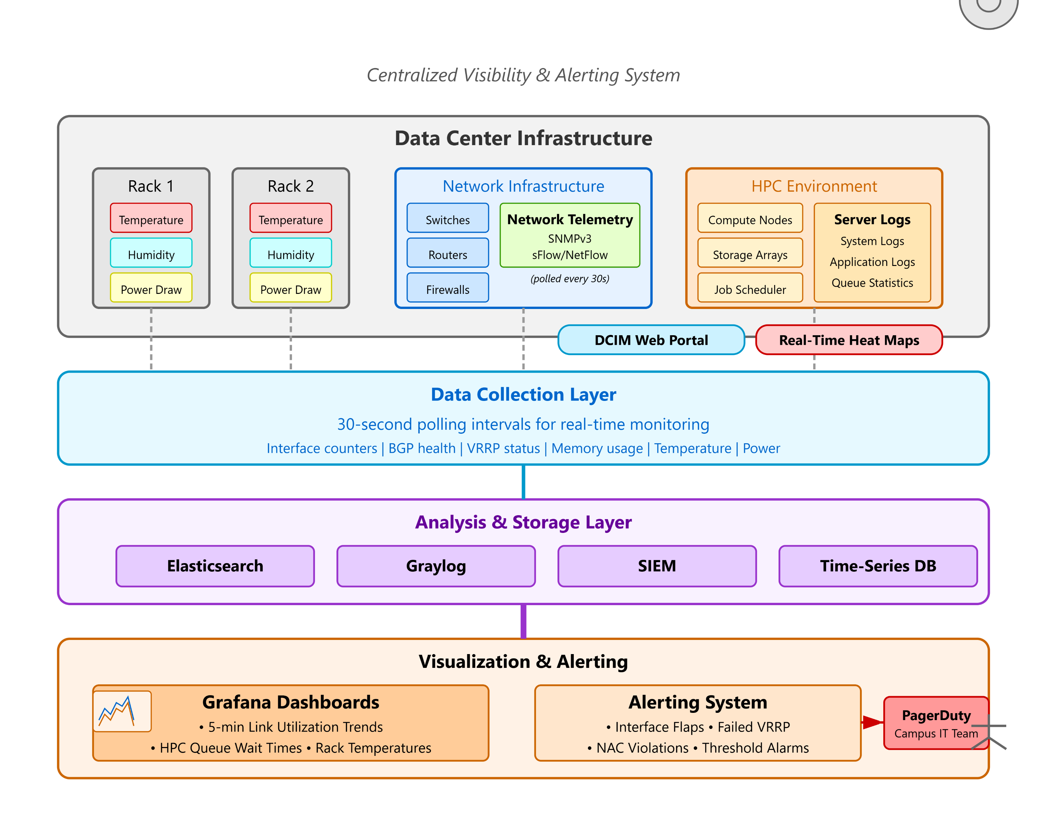
Monitoring and Management

Slide 29
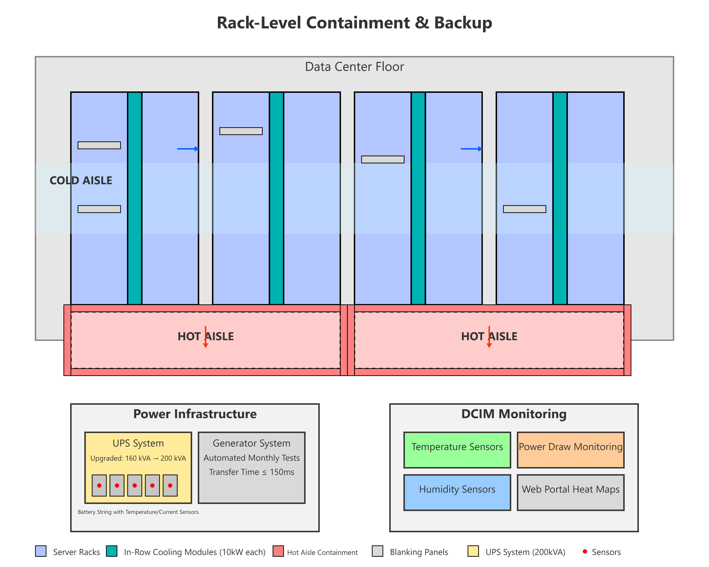
Power and Cooling Upgrades

Slide 30
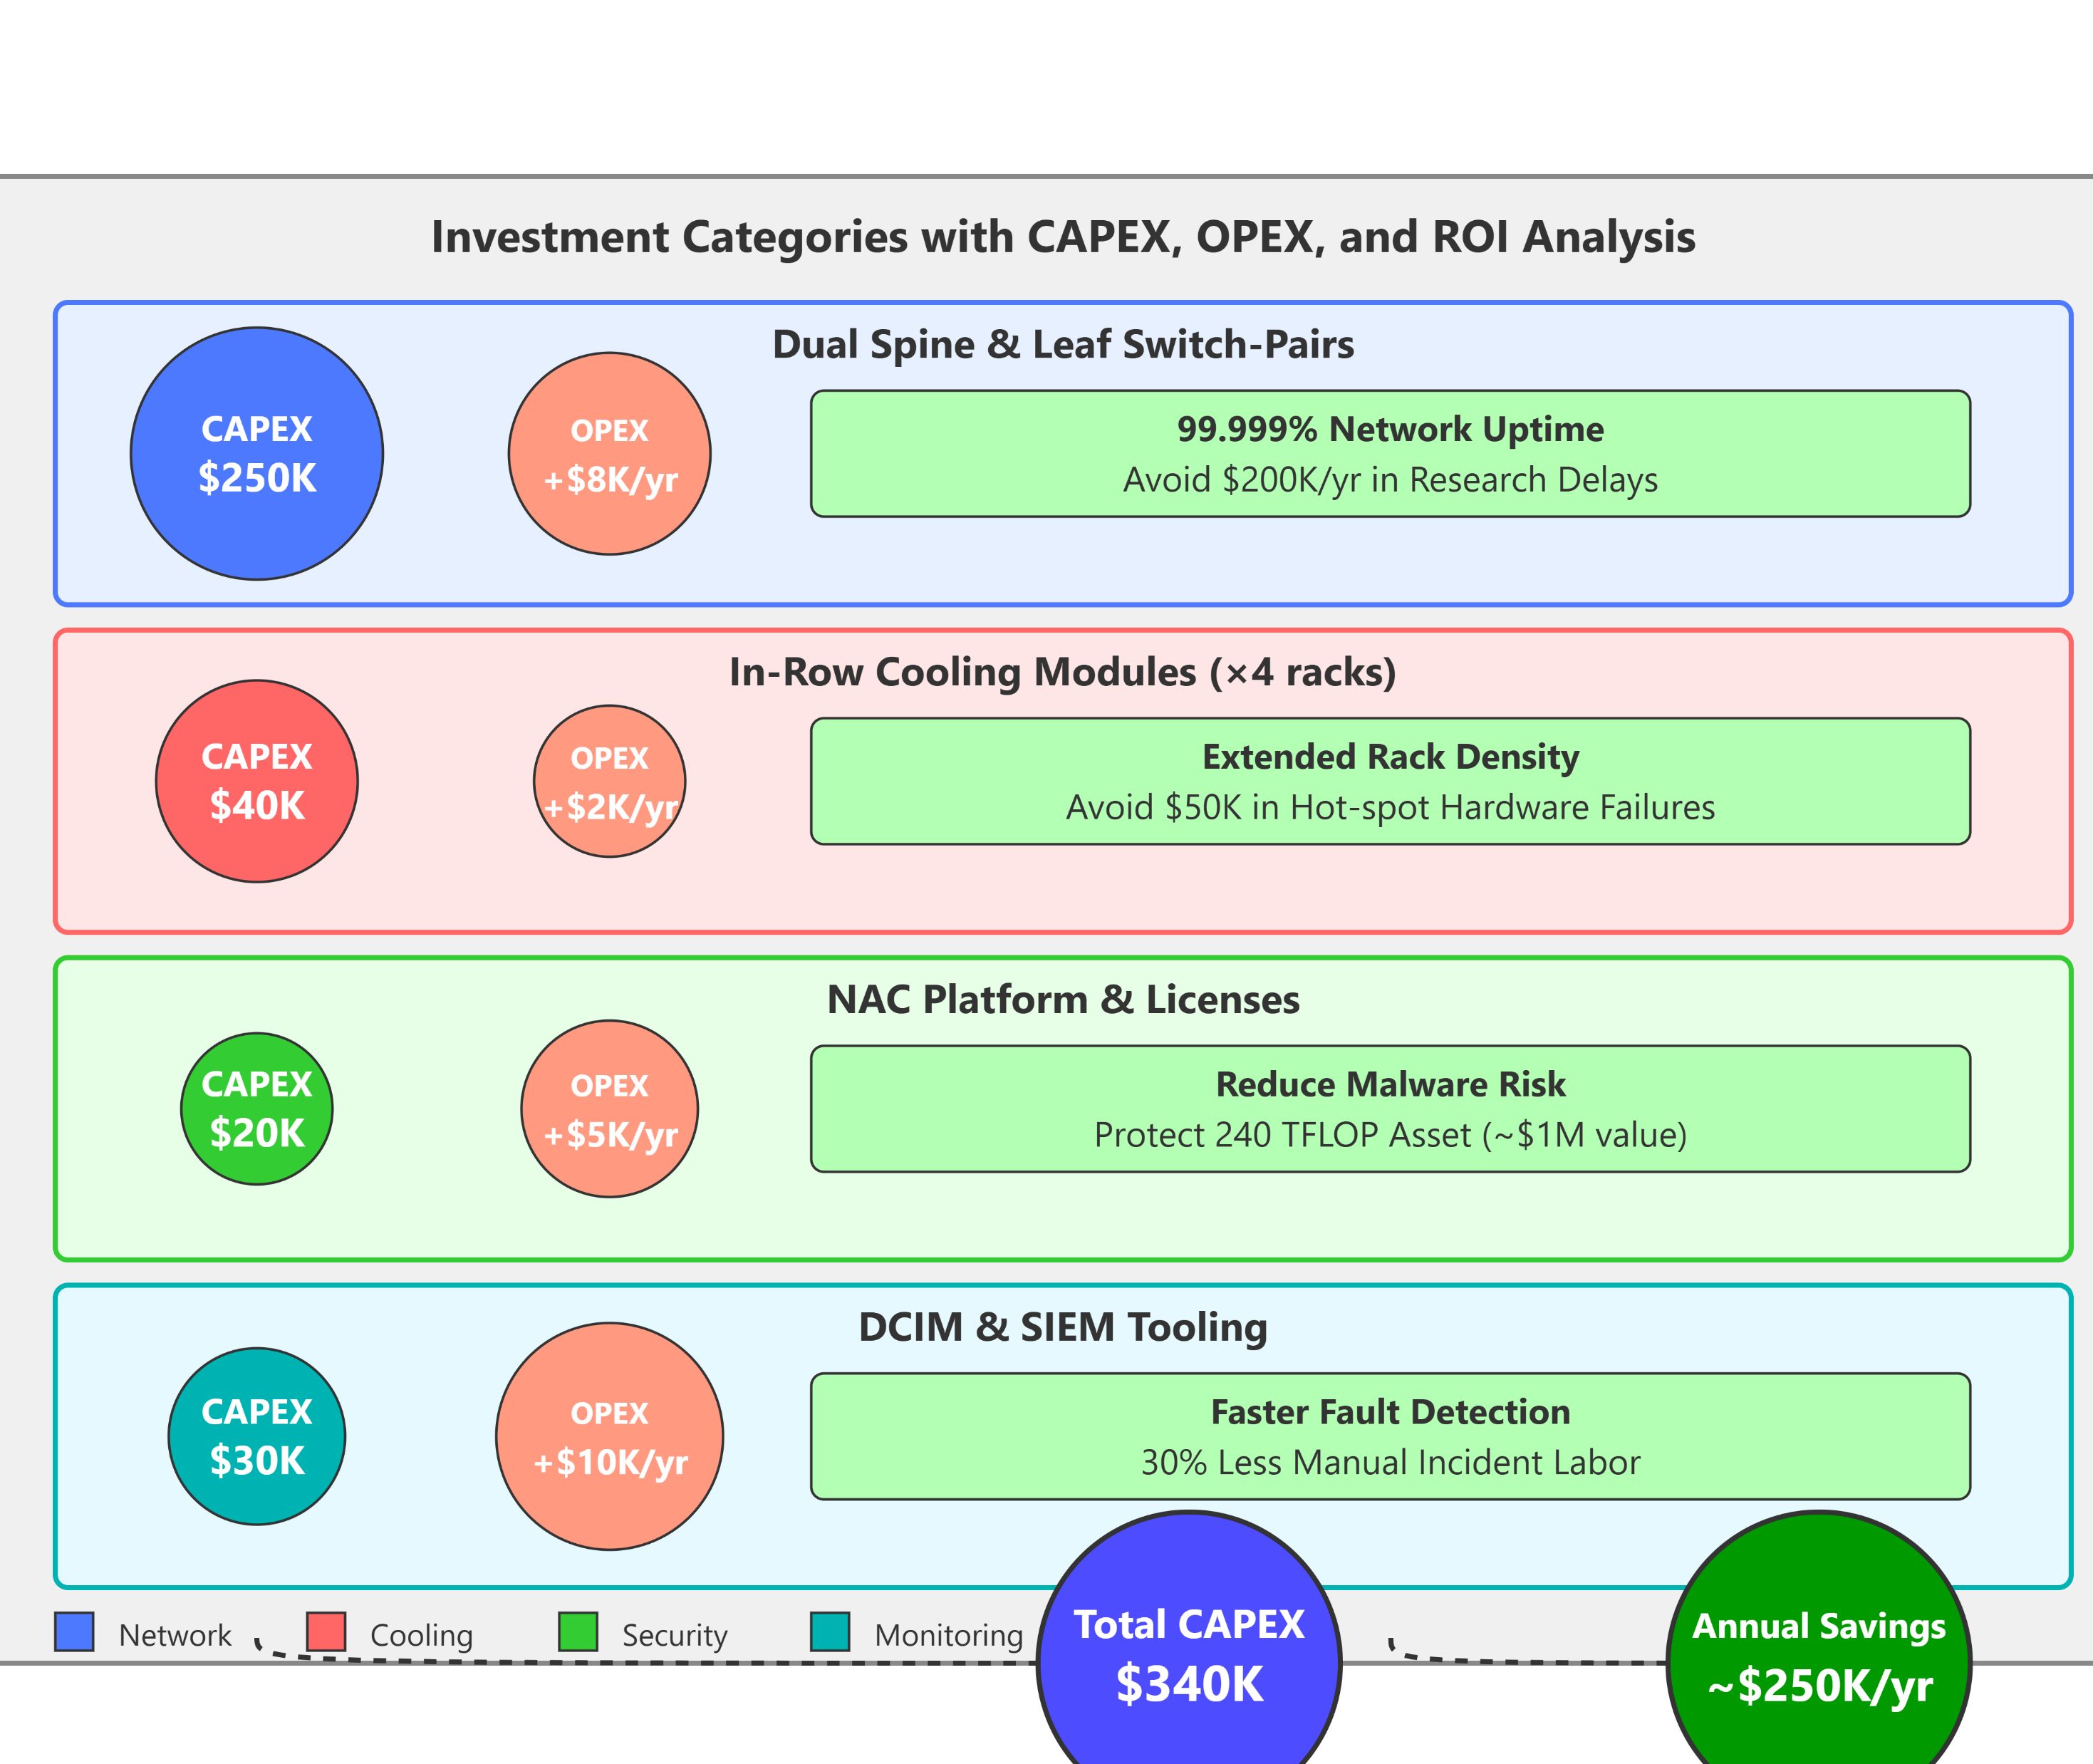
Cost Benefit Considerations

Slide 31
Analysis of Cost Benefit
Item | CAPEX | OPEX | Annual Savings
Dual Spine & Leaf | $250K | +$8K | Avoids $200K/yr in research delays (e.g., downtime during grant-funded projects).
In-Row Cooling | $40K | +$2K | Prevents $50K/yr in hardware failures (e.g., overheating-induced server crashes).
NAC Platform | $20K | +$5K | Mitigates malware risks (protecting a $1M HPC asset from breaches).
DCIM & SIEM | $30K | +$10K | Reduces manual labor by 30% (e.g., $100K/yr in IT staff time).
Total | $340K | +$25K/yr | Total Savings: 200K+200K+50K + 100K=100K=350K/yr

Slide 32
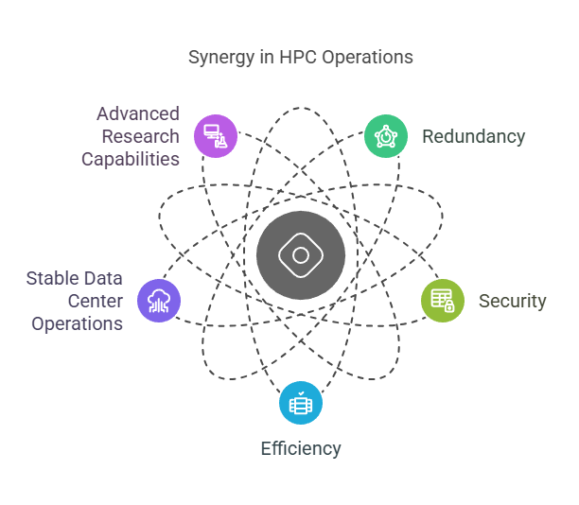
Conclusion

Slide 33

Thank You

